Slide 1

AI-Powered Banking Chatbot
Milestone-wise Implementation
Technologies: Python, NLP, spaCy, Streamlit,APIs
Timeline: 8 Weeks
Prepared by: Lavanya Yandapalli

Slide 2
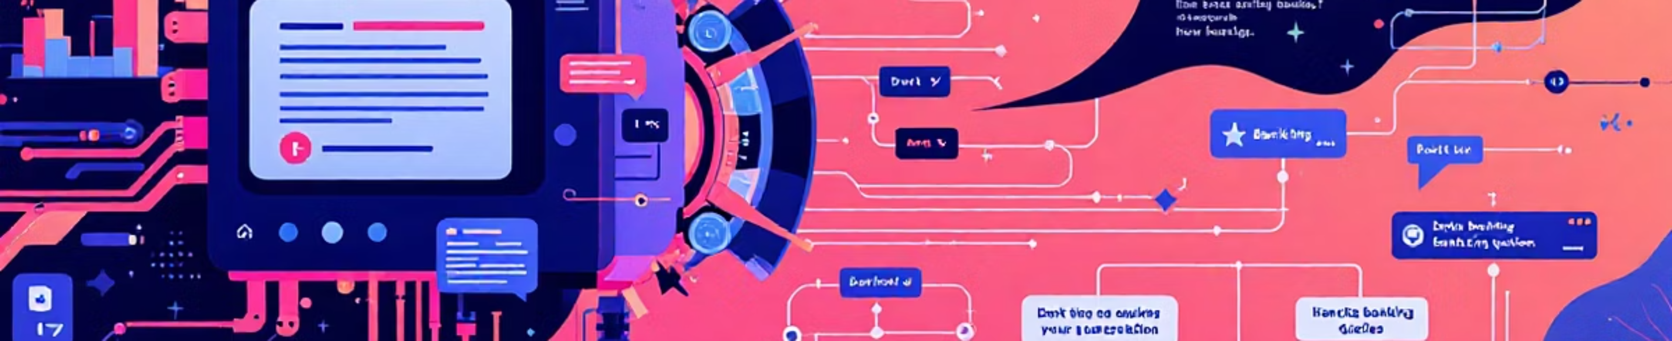
Milestone 1: Intent & Entity Recognition Engine
Objective & Scope
Design Natural Language Understanding (NLU) engine
Define core banking intents: Check Balance, Apply for Loan, Find ATM, Card Services
Identify entities: Account type, location, date, card type

Slide 3
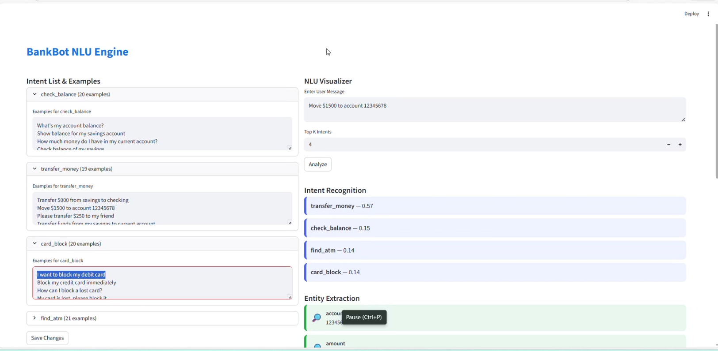

Milestone 1: Implementation & Outcome
Trained NLU model using spaCy / Rasa NLU
Intent classification with labeled examples
Entity extraction and slot filling logic
Tested intent accuracy using sample banking queries
Outcome:
Accurate intent detection and entity recognition, forming the foundation of conversational AI.

Slide 4


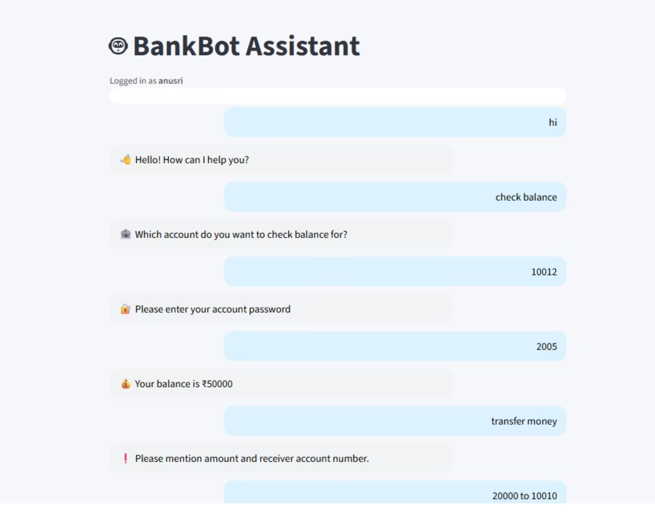
Milestone 2: Response & Dialogue Management
Objective
Manage multi-turn conversations seamlessly, ensuring a natural user experience.
Features
Context tracking within a user session
Rule-based and ML-based dialogue handling
Fallback handling for unknown queries
Optional escalation to human agent for complex issues

Slide 5

Milestone 2: Implementation & Outcome
1
2
Dialogue Flow Design
Fallback & Chitchat
Utilized rules and stories to map out conversational paths and user interactions.
Implemented robust handling for out-of-scope queries and casual conversations.
3
4
Context Memory
End-to-End Testing
Enabled session-based memory to maintain context throughout the conversation.
Thoroughly tested conversations to ensure reliability and continuity.
Outcome:
Natural, continuous, and reliable conversations, enhancing user satisfaction and efficiency.

Slide 6

Milestone 3: Web Interface & UI Integration
Objective
UI Design
Develop an intuitive and user-friendly chat interface for seamless interaction.
Responsive design for desktop and mobile
Dynamic chat bubbles and typing animation
Integrated bank branding with logo and avatar

Slide 7
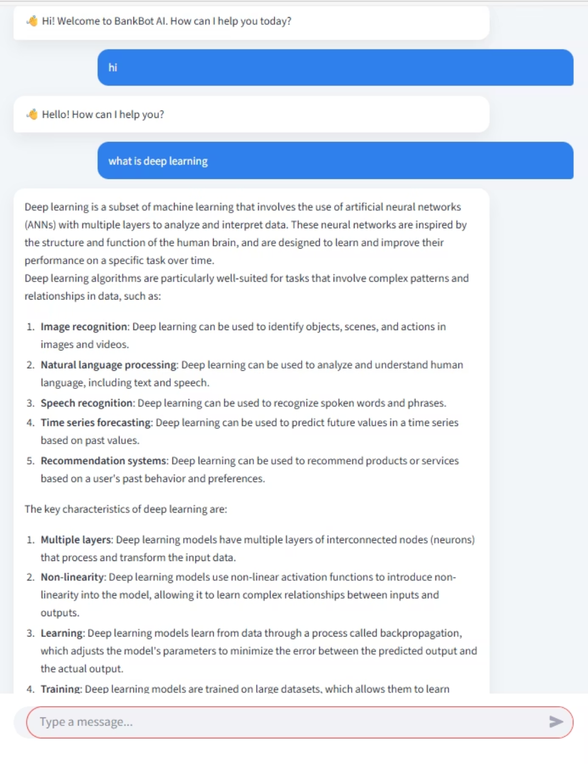

Milestone 3: Implementation & Outcome
Built web UI using Streamlit / Flask / React for a dynamic frontend.
Seamlessly connected frontend with the chatbot backend API.
Implemented comprehensive error handling and edge-case management.
Outcome:
A smooth and interactive banking chatbot interface, improving accessibility and user engagement.

Slide 8
Milestone 4: Admin Panel & Knowledge Base
Objective
Develop an admin panel for comprehensive chatbot management.
Admin Features
Upload and edit intents and training data
Manage FAQs and static content
Role-based login using JWT for secure access

Slide 9
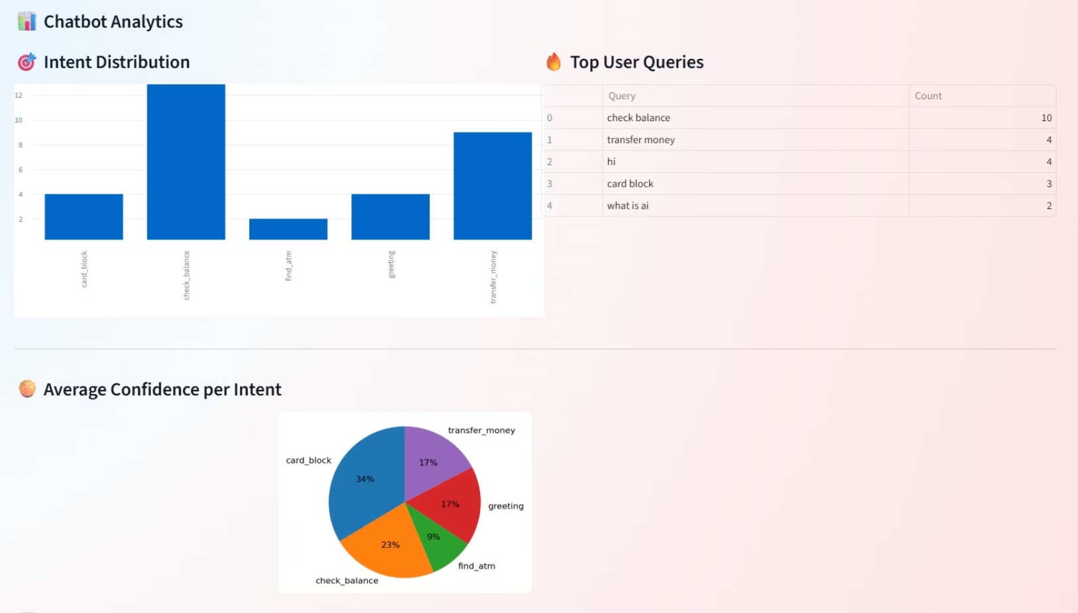

Milestone 4: Implementation & Outcome
Provided tools to view user interaction logs for performance analysis.
Enabled triggering chatbot model re-training with new data.
Export analytics and logs as CSV for further insights.
Integrated dummy external APIs for real-time data (e.g., account balance, exchange rate).
Outcome:
A fully manageable and scalable chatbot system, ensuring continuous improvement and operational efficiency.

Slide 10

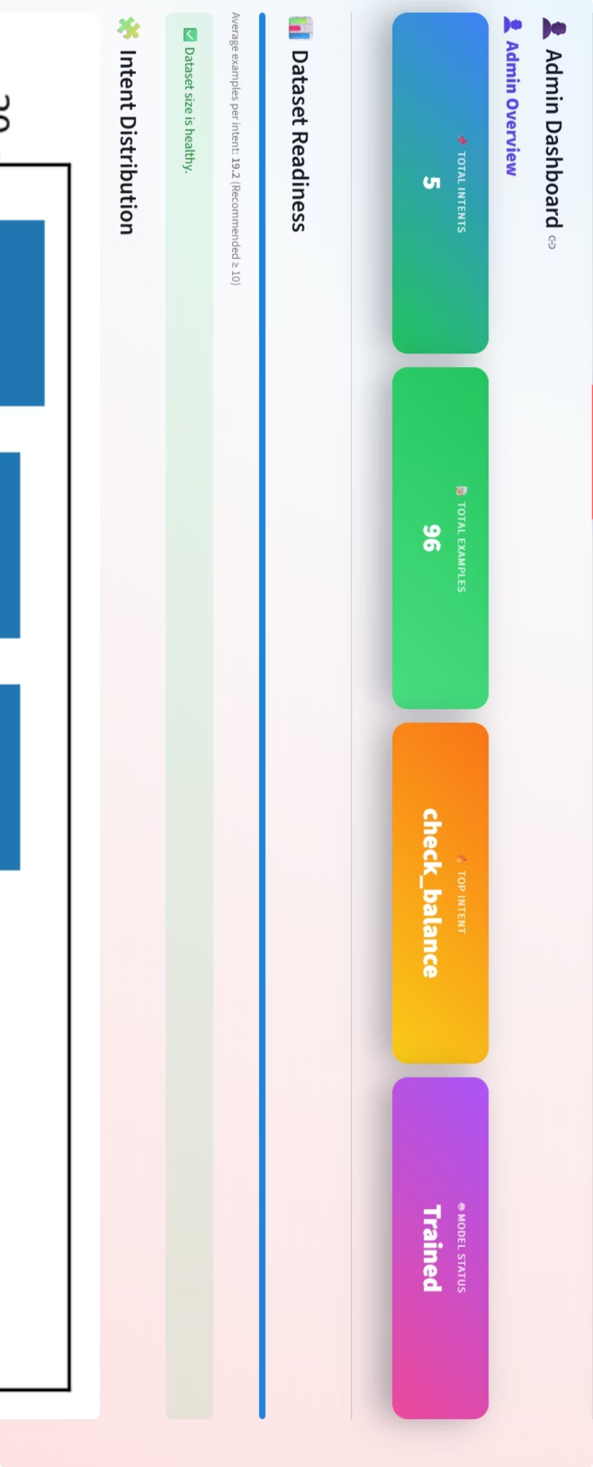
Conclusion & Future Enhancements
Successfully developed an AI-Powered Banking Chatbot through a structured, milestone-based approach.
Key Achievements
Intent & entity recognition engine
Advanced dialogue management and context tracking
Intuitive web-based chat interface
Robust admin panel with training and analytics capabilities
System Impact
Enables automated, secure, and scalable customer support, transforming banking interactions.
Future Enhancements
Integration with real banking APIs for live data
Multi-language and voice-based support for wider reach
Deployment on WhatsApp and mobile platforms
Advanced LLM-based conversational intelligence for richer interactions

